Slide 1


Slide 2
HTTP, HTML & Hypermedia
The Design Of The Web

Slide 3

The World Wide Web
In our last lecture, we looked at low level networking
In particular, we looked at how to use sockets to communicate between two computers over the network
Notes:
Can be found online… but I can’t link to it

Slide 4
The World Wide Web
We discussed some lower level protocols used on the internet:
IP - Internet Protocol
TCP - Transmission Control Protocol
Today we are going to talk about an higher level system built on top of these: the world wide web
Notes:
Can be found online… but I can’t link to it

Slide 5
The World Wide Web
It’s hard to understand, if you grew up with it, just how revolutionary the web was
Before the web, it was possible to just not immediately know sometime
You actually had to “wonder”: I wonder who the generals at Stalingrad were? I wonder who invented corn syrup etc.
Notes:
Can be found online… but I can’t link to it

Slide 6
The World Wide Web
The web is built on top of technologies built on top of the lower level technologies we discussed last time:
HTTP - The HyperText Transfer Protocol
HTML - The HyperText Markup Language
Notes:
Can be found online… but I can’t link to it

Slide 7
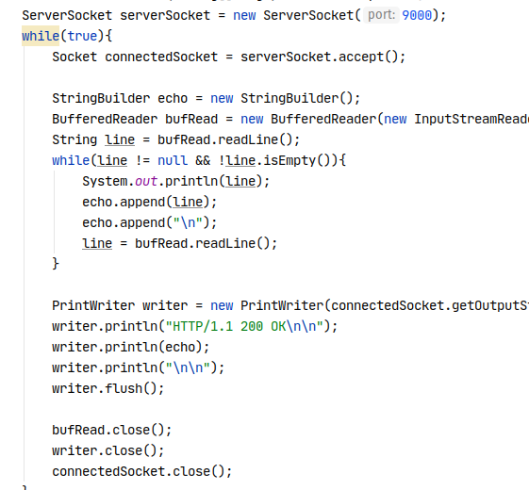
HTTP
In our last lecture, we were actually using HTTP!
We wrote a very simple (and very broken) HTTP client and HTTP server
Let’s take a look at the protocol, which is built on top of TCP/IP
Notes:
Can be found online… but I can’t link to it

Slide 8
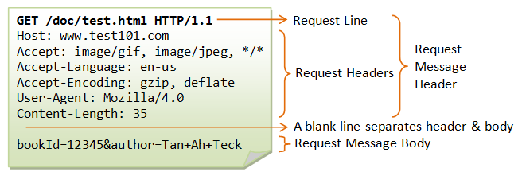
HTTP
The HTTP specification is pretty simple by networking standards
Worse is better!
Keep in mind, this is just a basic text format, there is nothing magic here!
Notes:
Can be found online… but I can’t link to it

Slide 9
HTTP
Note that an HTTP request has an “action”
GET - get a resource
POST - create/replace a resource
PUT - update/replace a resource
DELETE - remove a resources
This action tells the server what the request wants done
Notes:
Can be found online… but I can’t link to it

Slide 10
HTTP
HTTP requests and responses have “headers” which are just pieces of text that are at the start of each, with the funny <Name>: <value> syntax
Notes:
Can be found online… but I can’t link to it

Slide 11
HTTP
Response headers, in particular, are important
They can tell a browser, for example, to go to an entirely different URL
Notes:
Can be found online… but I can’t link to it

Slide 12
HTTP
Both Requests and Responses have optional bodies
The request at right has a form-encoded body of name/value pairs
A response body might be some HTML or possibly the binary data for an image
Notes:
Can be found online… but I can’t link to it

Slide 13
HTTP
This is all pretty simple, but it’s still a pain to get right if you are dealing with raw sockets
Most programming languages have built in HTTP client libraries for working with HTTP servers without needing to get into the muck
Notes:
Can be found online… but I can’t link to it

Slide 14
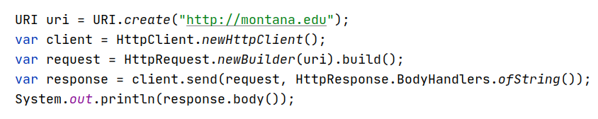
HTTP
At right we have rewritten our simple HTTP client to get the content at http://montana.edu to use the HttpClient class, which is baked into Java
First we create a URI
This is a URL as you are probably familiar from your browser’s address bar
Notes:
Can be found online… but I can’t link to it

Slide 15
HTTP
We create a new HttpClient using a Factory method
We then build a request for the URI, using a Builder Pattern
Finally we send the request, telling the client that we want the body to just be a string
Could also be a byte array or some other options
Notes:
Can be found online… but I can’t link to it

Slide 16
HTTP
As you can see, this is a much nicer API for working with a remote HTTP system than dealing with raw sockets and strings
But, underneath, it’s doing the same stuff we did last lecture!
Notes:
Can be found online… but I can’t link to it

Slide 17

HTTP Servers
There are also higher level libraries for creating HTTP servers
One of my favorites is Javalin: https://javalin.io/ A very lightweight library that lets you create a webserver in java in minutes
Notes:
Can be found online… but I can’t link to it

Slide 18
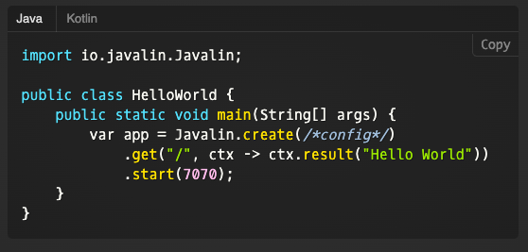
HTTP Server Code
At right is some simple Javalin code that will start a web server up on port 7070 that will respond to requests for the root path (/) with “Hello World”
Quick talk about closures
Easy peasy!
Notes:
Can be found online… but I can’t link to it

Slide 19
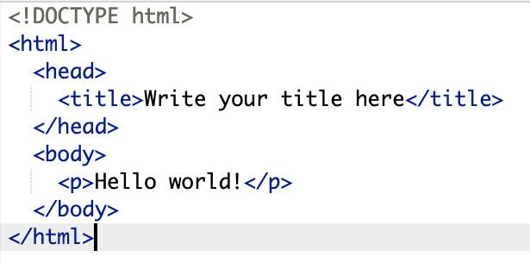
HTML
HTTP, as the name suggests, was designed in order to transfer HyperText
The most popular HyperText in the world is HTML
HTML is a hypertext, which is a subset of a hypermedia
Notes:
Can be found online… but I can’t link to it

Slide 20
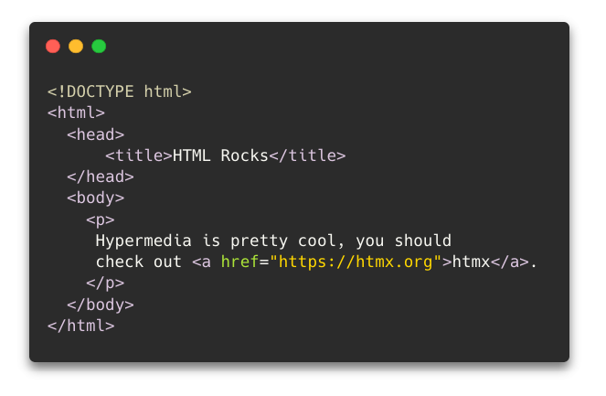
HTML
A hypermedia is any media that allows for non-linear interaction via hypermedia controls
At right is a simple HTML document:
It is an XML-like language
Tags are used to enclose content
Notes:
Can be found online… but I can’t link to it

Slide 21
HTML
The reason this page is a hypermedia is because of that funny <a> tag
This is called an anchor tag and it is a hypermedia control
A proper web client will render this anchor tag as a link, with the text “htmx”
Notes:
Can be found online… but I can’t link to it

Slide 22
HTML
If the user clicks on that link, they will be taken to the website https://htmx.org
A very good website!
Notes:
Can be found online… but I can’t link to it

Slide 23
HTML
So HTTP, HTML and a piece of software called A Browser come together to make this hypermedia system called The Web work
It turns out that hypermedia systems are an interesting and distinct network architecture
Notes:
Can be found online… but I can’t link to it

Slide 24
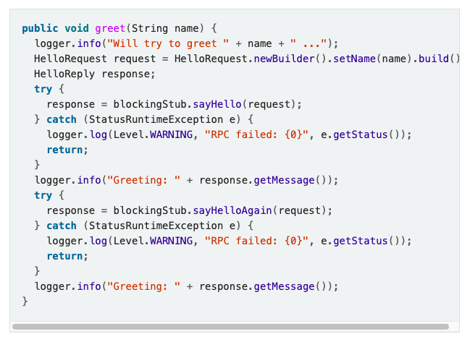
RPC
To understand how hypermedia is distinct as a network architecture we need to look at another alternative: Remote Procedure Calls (RPC)
The most popular RPC library is called gRPC, by google
Notes:
Can be found online… but I can’t link to it

Slide 25
RPC
Without getting into the gory details, network interactions are done in a functional manner, as if you are calling a function on the remote system
The gRPC library makes it look like you are just invoking a local function
Still a ton of junk, not a huge fan of google’s design sensibilities
Notes:
Can be found online… but I can’t link to it

Slide 26

RPC & JavaScript
Today, the RPC style is very popular, even in web development
Front end JavaScript frameworks like React, Vue and Svelte allow you to build sophisticated user interfaces, and you are expected to sync the UI data with the server using what is effectively RPC
Notes:
Can be found online… but I can’t link to it

Slide 27
RPC & JavaScript
RPC in JavaScript typically uses a format called JSON
JSON is just a simple, JavaScript friendly syntax for presenting nested data
Notes:
Can be found online… but I can’t link to it

Slide 28
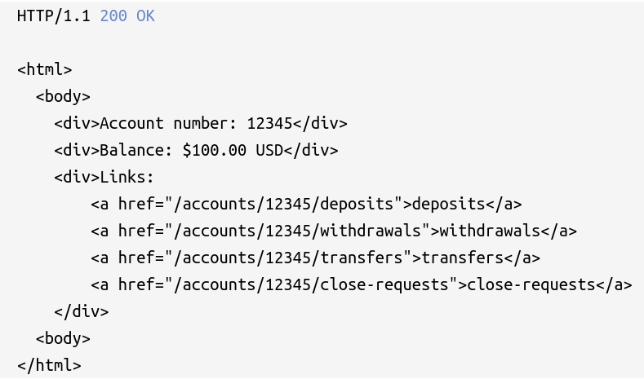
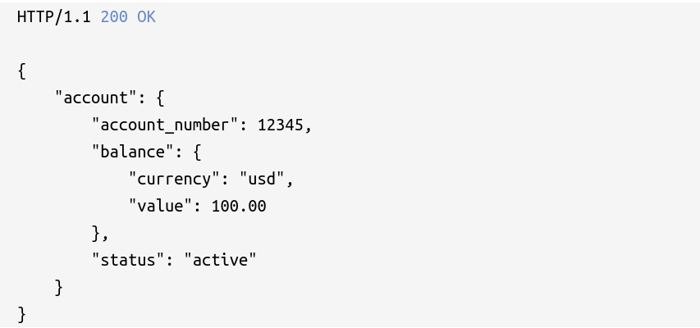
Hypermedia vs RPC
Let’s look at two network responses that might be found on the web
The first is a hypermedia (HTML, yay!)
The second is JSON (boo!)
Notes:
Can be found online… but I can’t link to it

Slide 29
Hypermedia vs RPC
These are both representations of a bank account in good standing
Note that the hypermedia representation encodes not just the balance, etc. but also encodes all the actions available on the account
Notes:
Can be found online… but I can’t link to it

Slide 30
Hypermedia vs RPC
The JSON representation is more efficient: it simply encodes a status flag
However, the client is responsible for interpreting this information and displaying the appropriate actions
Notes:
Can be found online… but I can’t link to it

Slide 31
Hypermedia vs RPC
While the JSON encoding is more efficient, it requires a client to understand the concept of a bank account and a bank account status
The hypermedia representation does not require that of a client
The interface is uniform, that is just hypermedia
Notes:
Can be found online… but I can’t link to it

Slide 32
Hypermedia vs RPC
Now consider when an account goes into an overdrawn status
What do the responses look like?
Notes:
Can be found online… but I can’t link to it

Slide 33
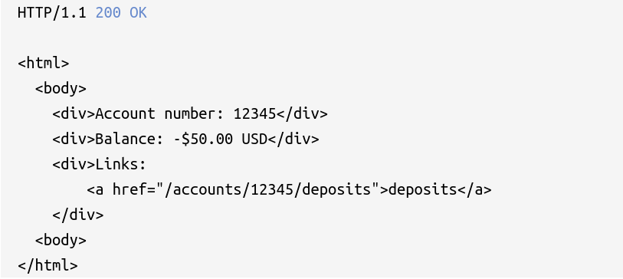
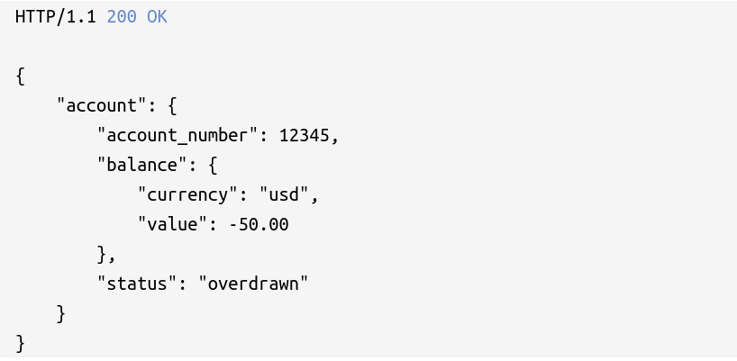
Hypermedia vs RPC
Now consider when an account goes into an overdrawn status
What do the responses look like?
Note that the JSON response is largely the same: the status and value fields have changed
Notes:
Can be found online… but I can’t link to it

Slide 34
Hypermedia vs RPC
An RPC client must understand this status and render the appropriate UI
In the case of the hypermedia response, the server simply renders a different set of links
The browser knows nothing about being “overdrawn” or, in fact, what a bank account even is
Notes:
Can be found online… but I can’t link to it

Slide 35
Hypermedia vs RPC
Because of this flexibility, hypermedia-based applications do not suffer from API churn issues: all “API” calls are surfaced through hypermedia and can change dramatically based on context, new features and so forth
Very flexible!
Notes:
Can be found online… but I can’t link to it

Slide 36

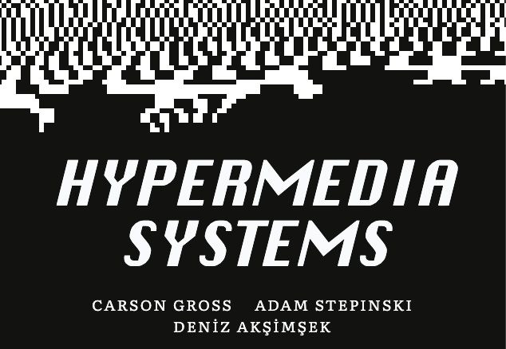
Hypermedia vs RPC
It is way, way beyond the scope of this class, but if it isn’t already apparent, I am a big fan of the hypermedia network architecture
I have a library that I wrote to make hypermedia-based web applications more powerful: https://htmx.org
Notes:
Can be found online… but I can’t link to it

Slide 37
Hypermedia vs RPC
And I also wrote a book on how to build hypermedia systems: https://hypermedia.systems
Will be teaching a class on this in Fall 2024!
Notes:
Can be found online… but I can’t link to it

Slide 38
HTTP, HTML & Hypermedia
HTTP is a simple protocol for transferring hypertext
Hypertext is a text form of hypermedia
The distinguishing characteristic of hypermedia is the presence of hypermedia controls
Hypermedia controls allow a user to interact in a non-linear manner with the media
The canonical hypermedia control is the anchor tag
Hypermedia is a unique network architecture when compared with, for example, the RPC style
Hypermedia is very flexible, at the cost of some representational efficiency

